Slide 1
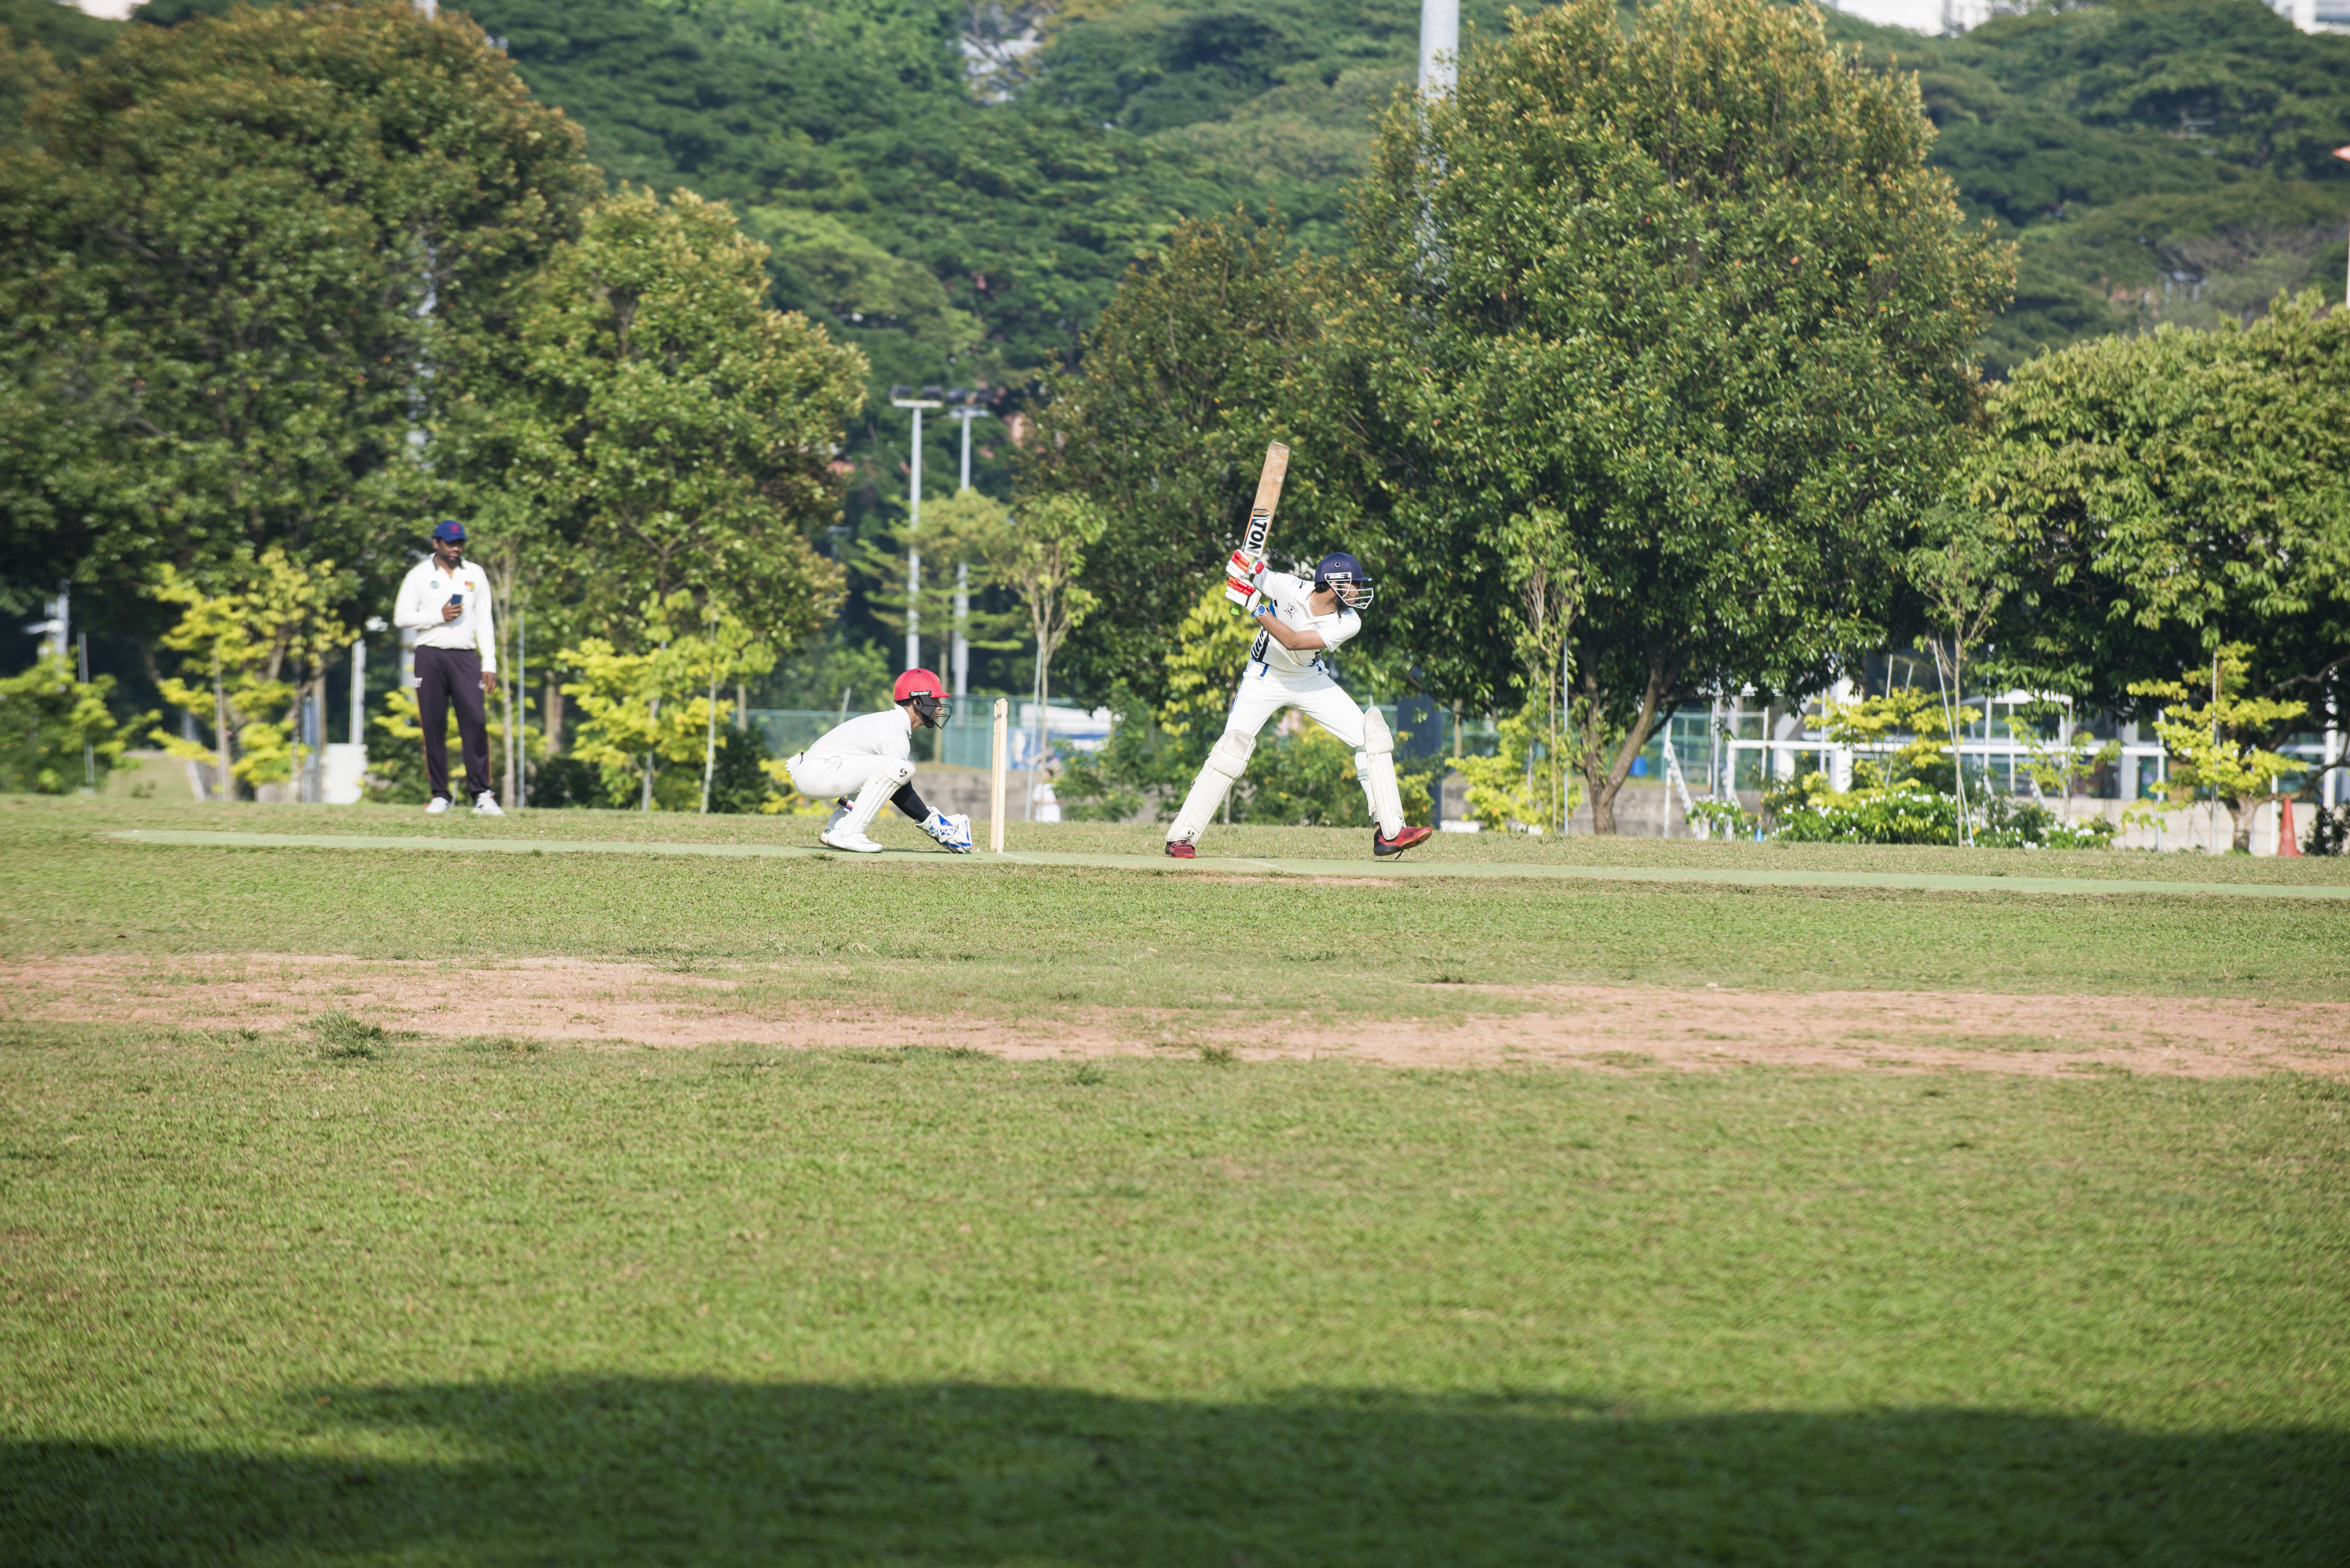
Train Your Batting
20XX
Divyansh Sharma

Slide 2
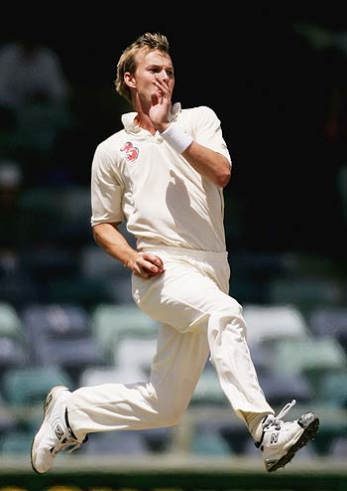
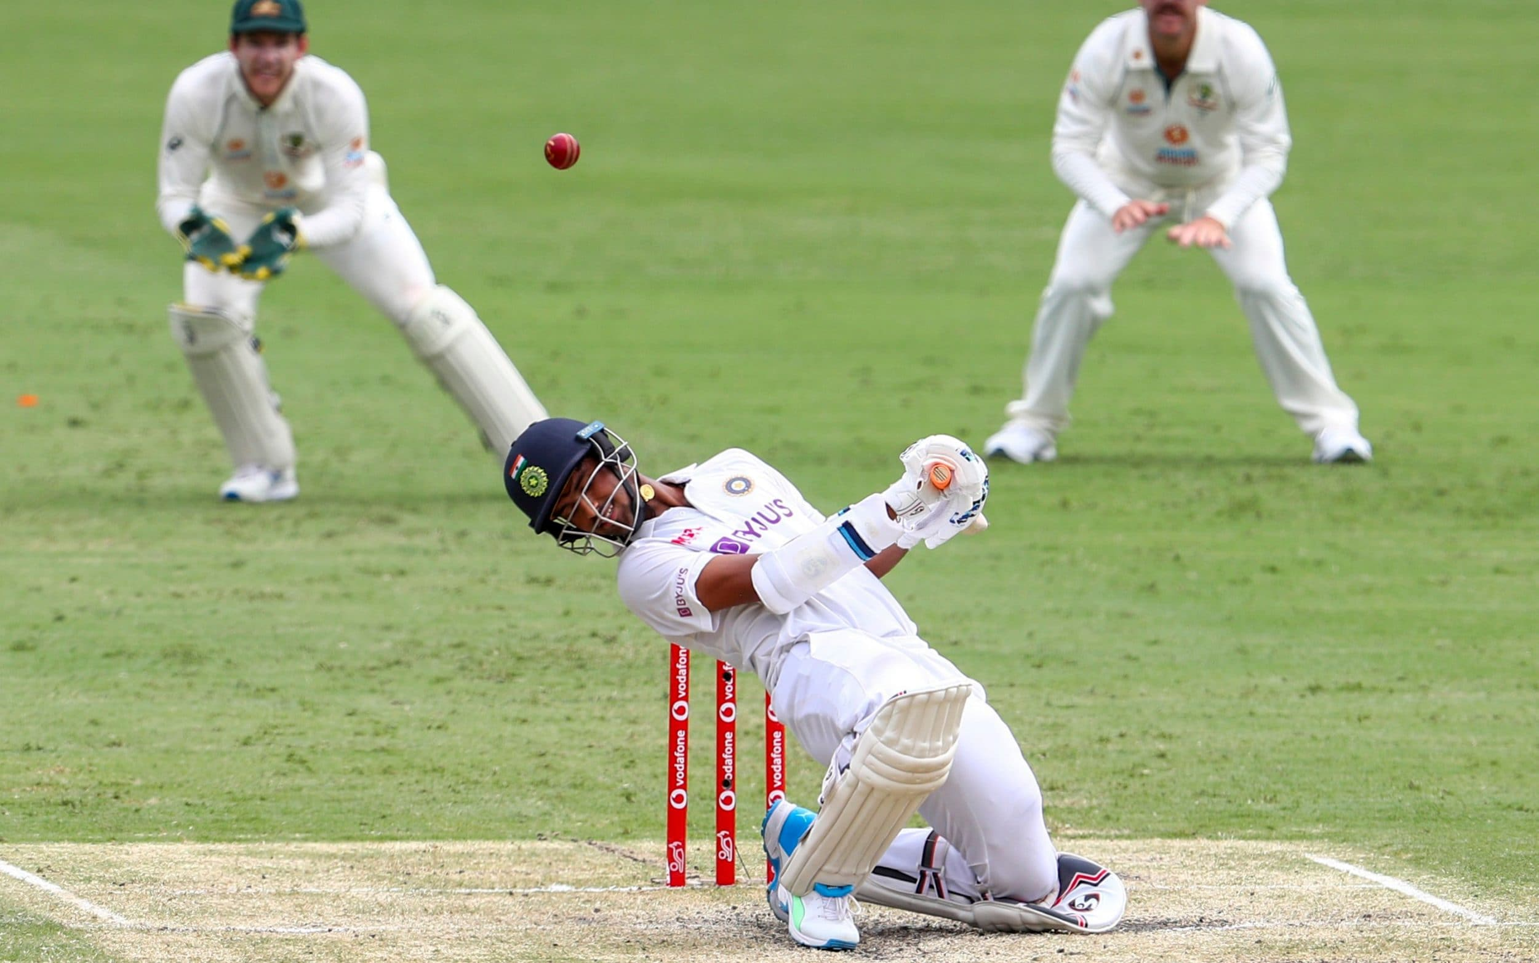
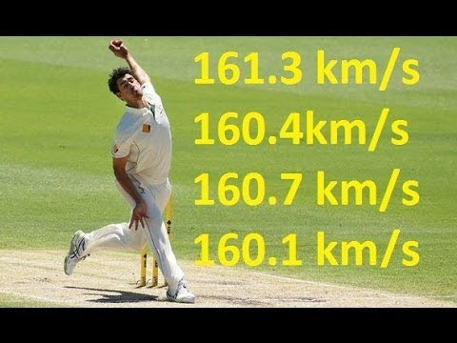
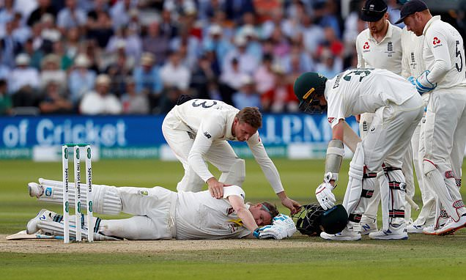
How to face fast bowling?
20XX
Reaction time of 200ms
Problem Identified
Select correct shot
Select fast enough
Improve reaction time of batters
Remote practice option
Prevent fatal injuries.

Slide 3
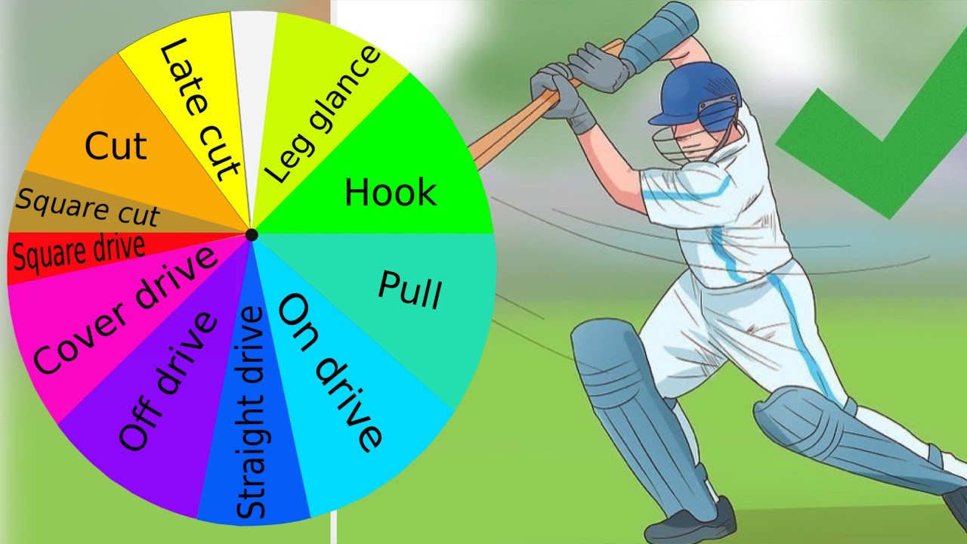
Data Collection
10mins per each shot
Shot | Time Taken
Cover Drive | 10 mins
Pull Shot | 10 mins
On Drive | 10 mins
Square Cut | 10 mins.
Idle | 10 mins

Slide 4
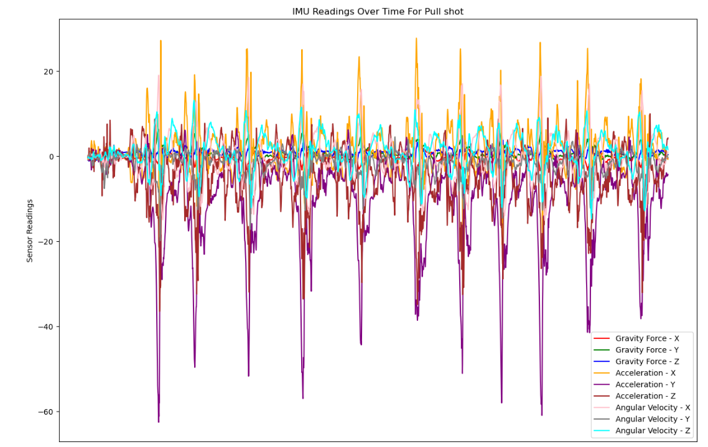

Slide 5
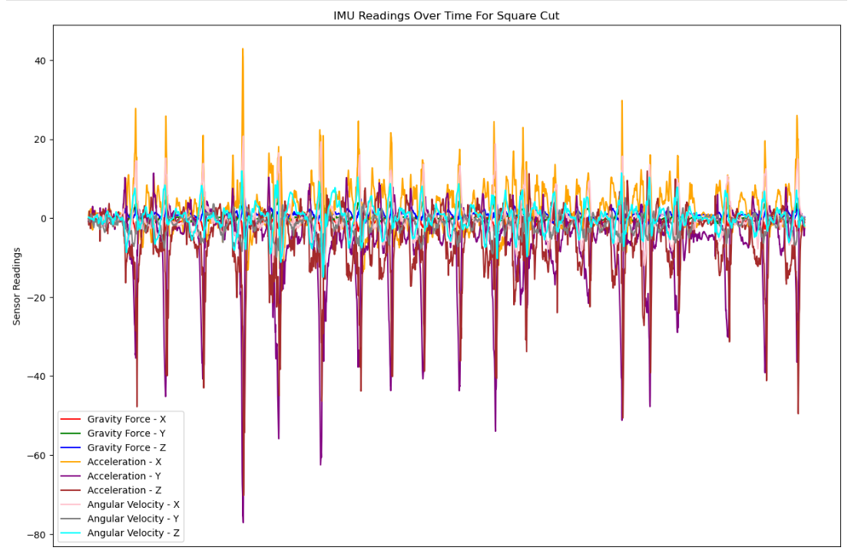

Slide 6
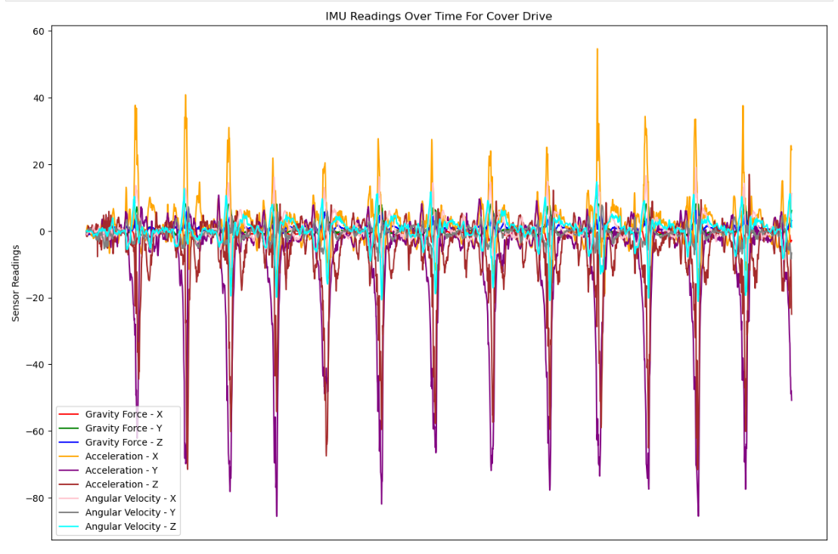

Slide 7
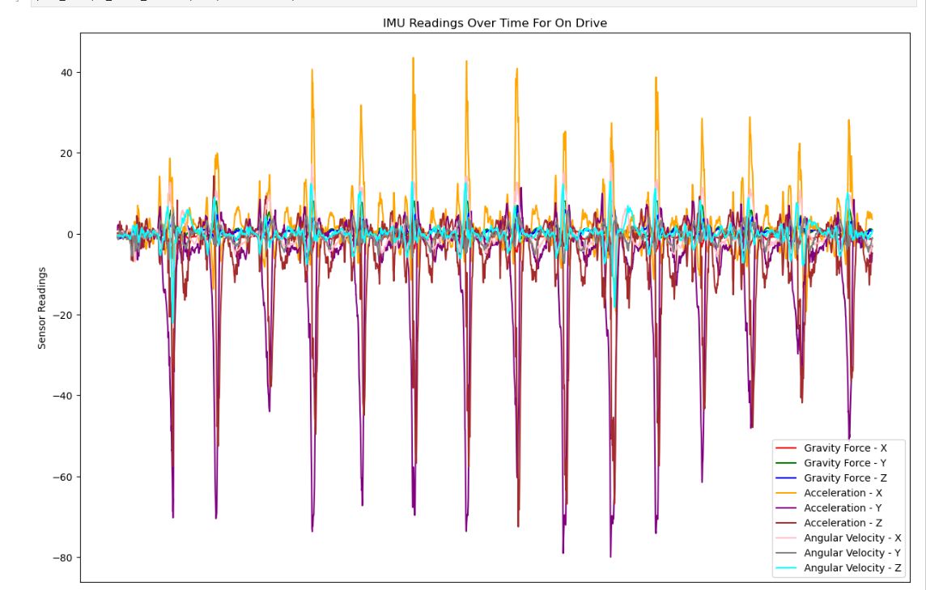

Slide 8
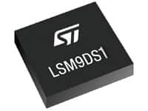

Shot Classification Model
IMU
Ax, Ay, Az, Gx, Gy, Gz
Feed Forward
Neural Network
Cover Drive
1
On Drive
2
Cover Drive
3
On Drive
4

Slide 9
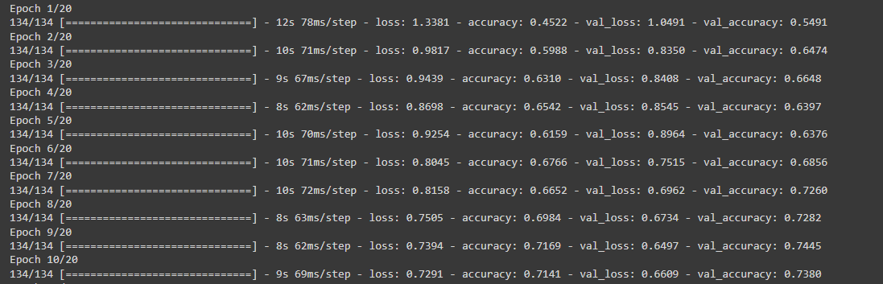
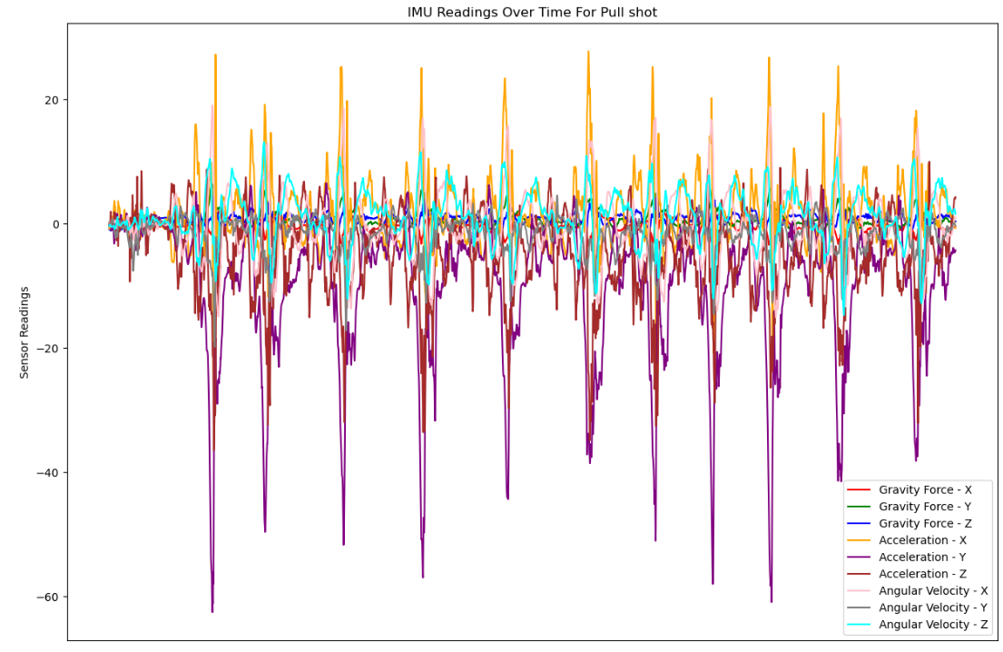
RNN, LSTMS First Attempt
Maximum Accuracy of 74%
Time Series Data

Slide 10
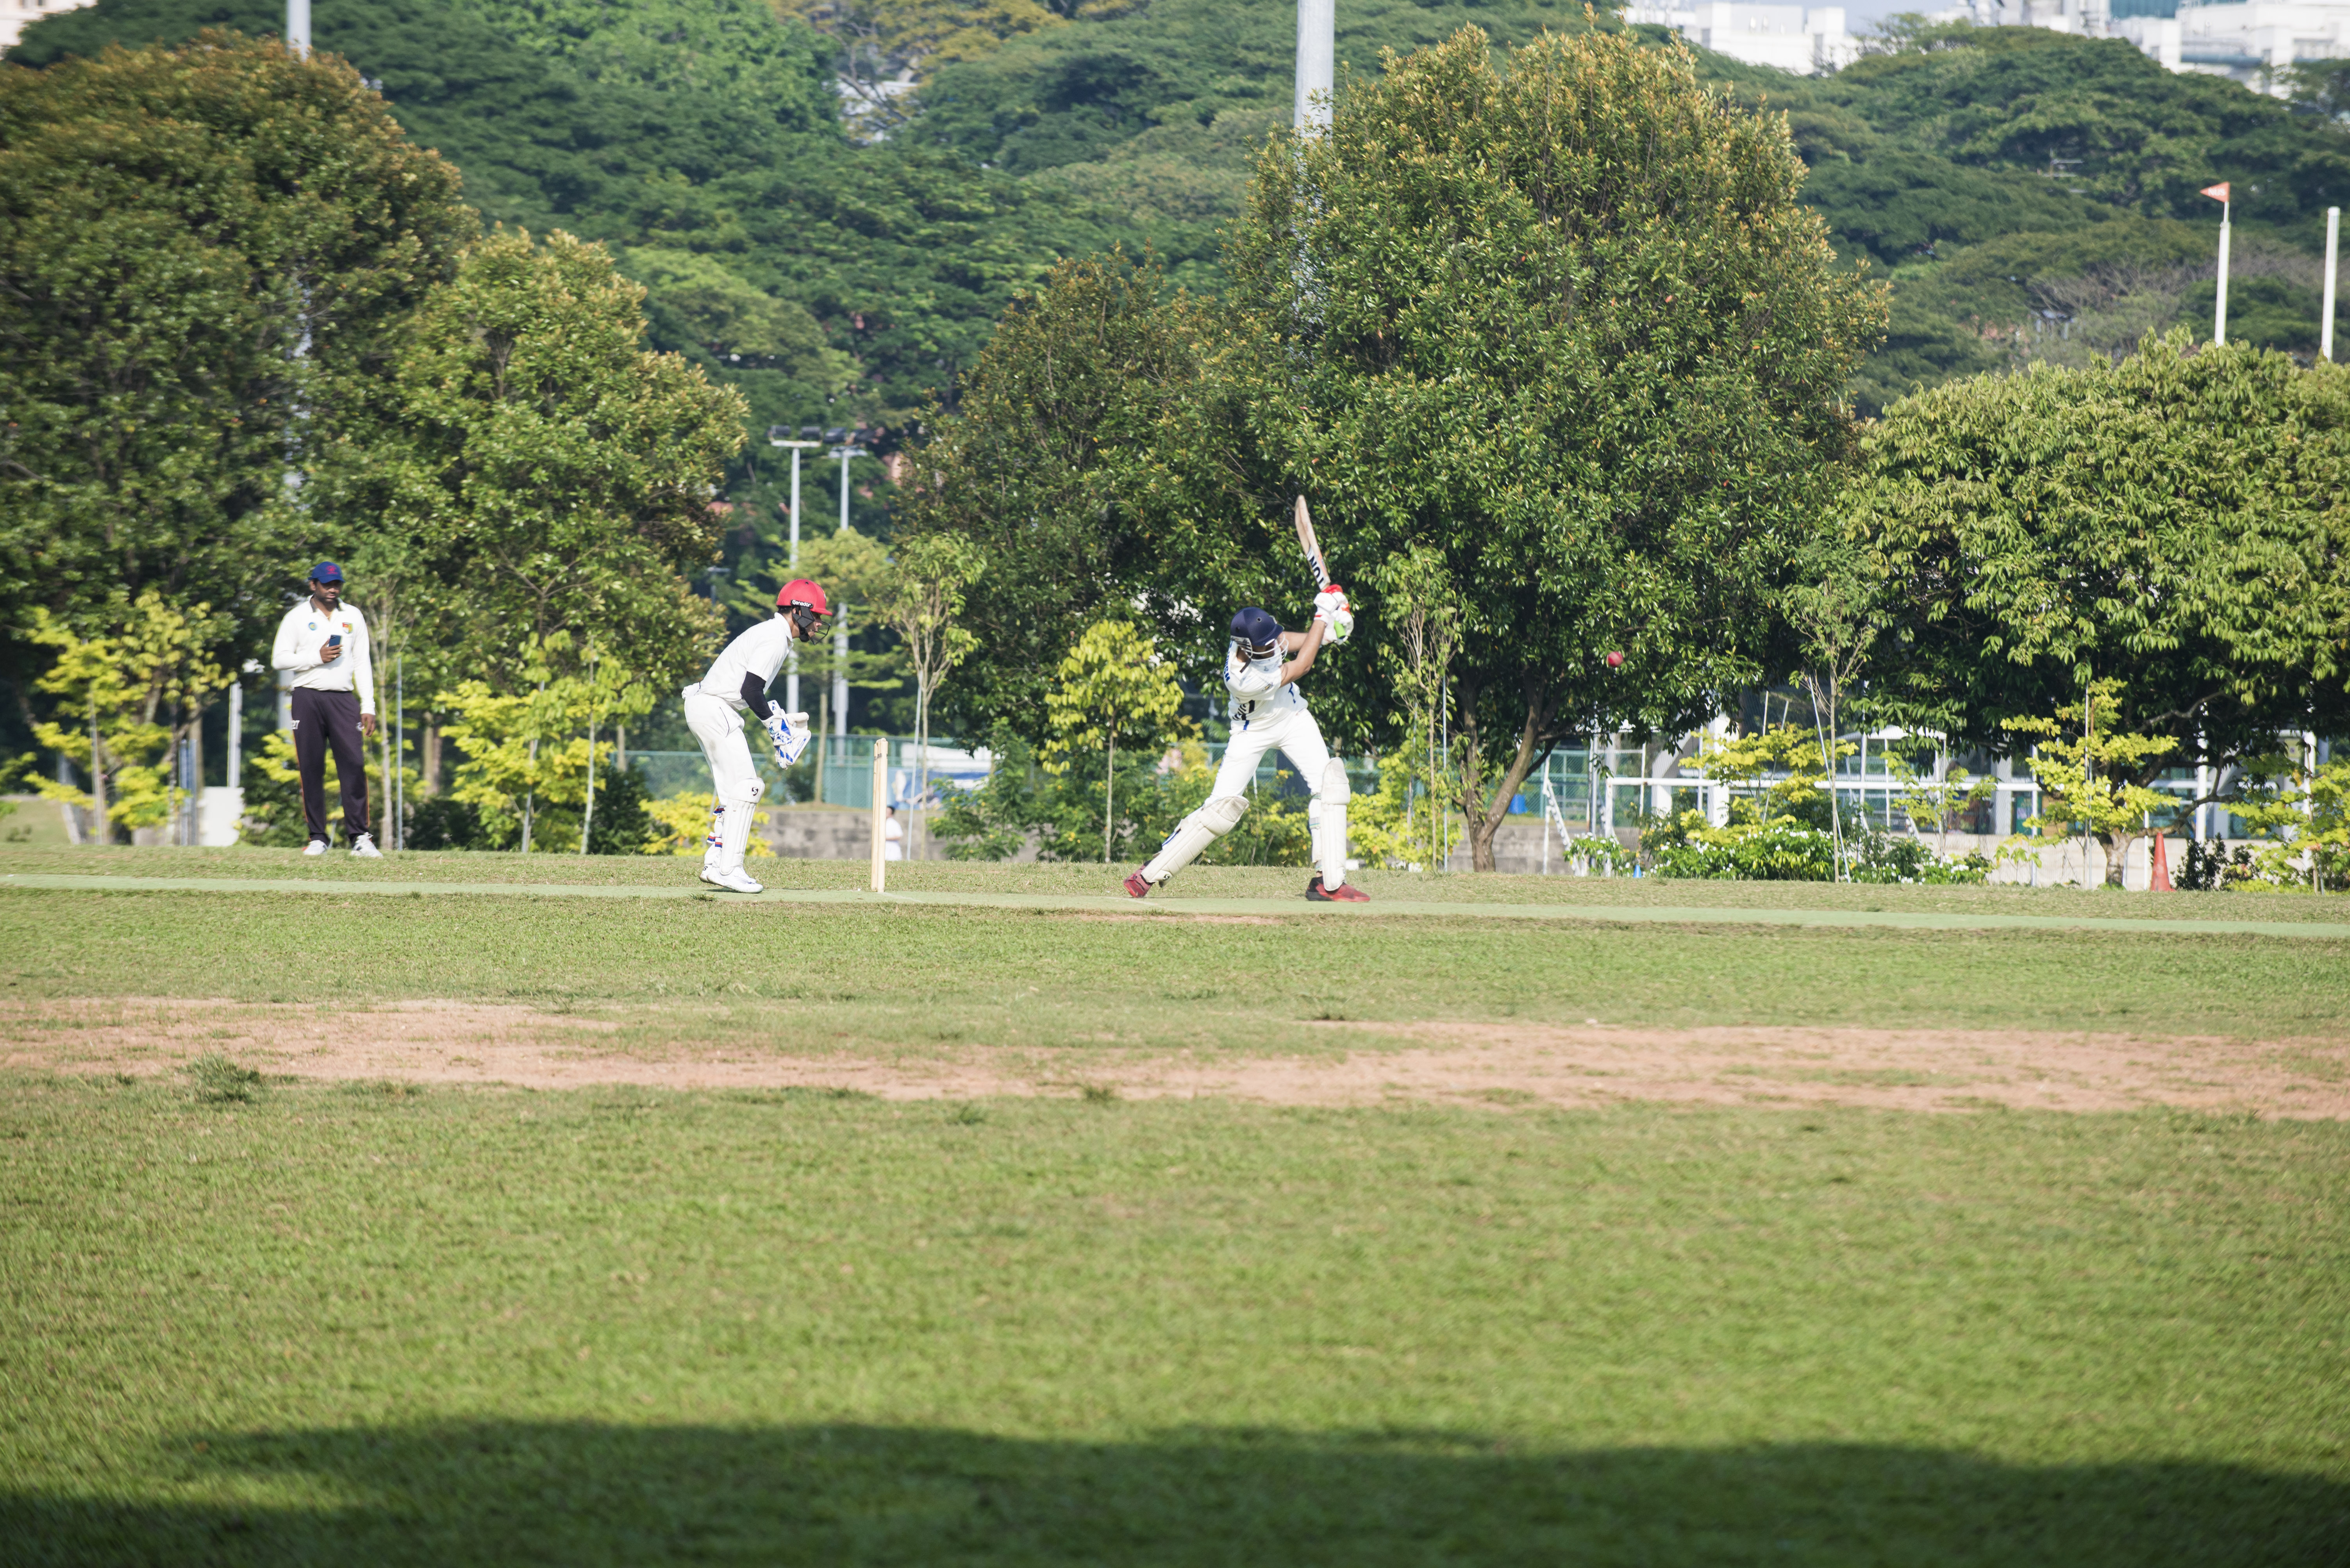
Feature Engineering and Feed Forward Neural Network
Popular method in literature for accurate results.
Features | Information
Mean | -
Standard Deviation | -
Root Mean Square | Quantifying the energy of the signal
Skewness | Assymetry of the signal. Indicative of specific type of motions
Spectral Skewness | Identifying frequency related patterns in the movement
Spectral Power in Frequency Bands | How energy is distributed among frequencies

Slide 11
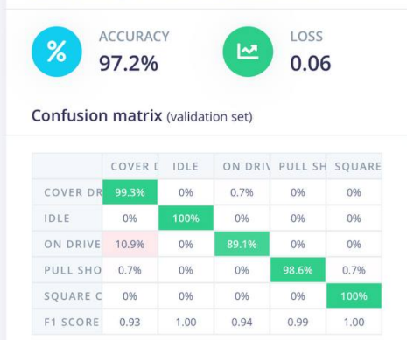
Feature Generation
Syntiant IMU
1800 features
Memory Size: 200Kb.

Slide 12
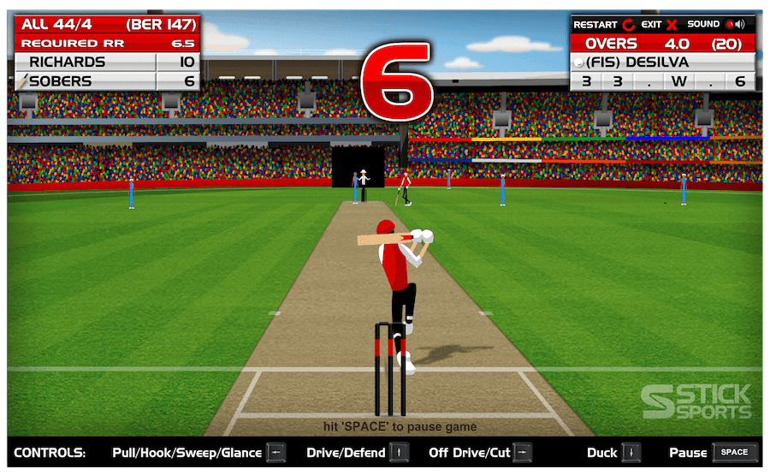
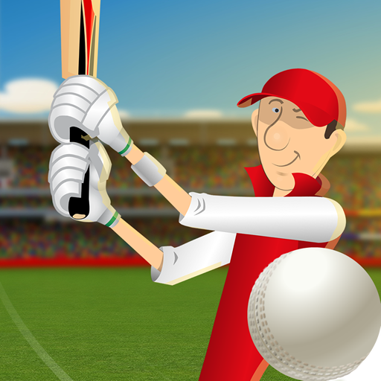
Play Stick Cricket
Another objective
0
2.8s
Popular Cricket Game challenging the ‘reflex’ of batsman.
Aim is to replace the keyboard press with Arduino
Latest Time to play
shot
Marker Display

Slide 13
Improvements
20XX
Select Important Features
Full Integer Quantization
Features that did not show any correlation with the labels are removed.
This reduces the computation and memory required by the model
Reduced from 1800 to 78 features
Conversion from 32bit integer to 8bit integer
Considerably reduced model size.

